Slide 1

Database Systems SQL Constraints(Part-2)& Retrieval Queries
CS 372
LAB 4

Slide 2


Lab objective
SQL Constraints: PRIMARY KEY & FOREIGN KEY
1
2
Basic Retrieval Queries in SQL: SELECT Query-> Where
3
Basic Retrieval Queries in SQL:
SELECT Query-> Order by

Slide 3


SQL CONSTRAINTS

Slide 4
Constraints
Constraints
NOT NULL
CHECK
DEFAULT
PRIMARY KEY
FOREIGN KEY
UNIQUE

Slide 5
5. Primary Key
PRIMARY KEY constraint creates a primary key for the table.
The PRIMARY KEY constraint uniquely identifies each record in a database table.
Primary keys Conditions:
Primary keys must contain unique values.
primary key column can not contain NULL values.
Each table should have Exactly one primary key.
You Can add Primary Key Constraint:
1. when a table is created:
Table level | Column level
CREATE TABLE table_name ( column_name Datatype ,…., CONSTRAINT Constraint_Name PRIMARY KEY (column_name) ) | CREATE TABLE table_name ( column_name Datatype PRIMARY KEY , …, )

Slide 6

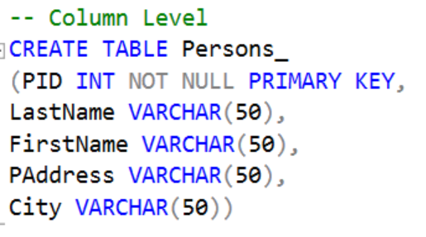
5. Primary Key(cont…)
EX:

Slide 7
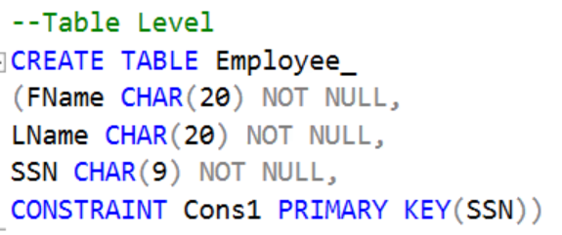
5. Primary Key(cont…)
EX:

Slide 8

5. Primary Key(cont…)
After the table is created
EX:
Alter Table table_name
Add Primary key (coulmn_name)
NOTE:
When Alter a column to be a primary key after table is created,
sometimes you get an error.
To solve that you must Add to the column not null constrain first.
Then, add the primary key to the column.

Slide 9
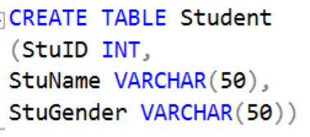
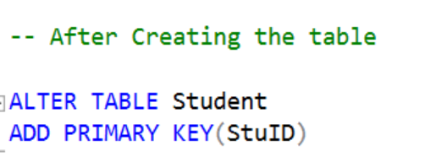

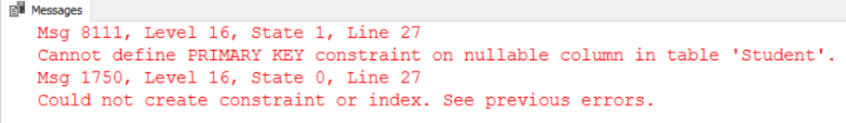
5. Primary Key(cont…)

Slide 10
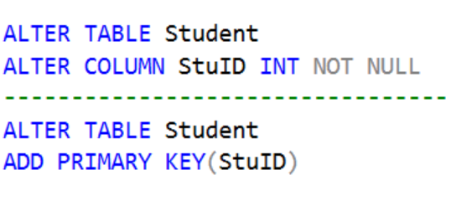
5. Primary Key(cont…)
1) Add to the column not null constrain
2) Add the primary key to the column

Slide 11
5. Primary Key(cont…)
You Can add composite Primary Key Constraint:
When a table is created:
We can add by (table level only )
CREATE TABLE table_name ( column_name Datatype ,….,
CONSTRAINT Constraint_Name PRIMARY KEY (column_name1, column_name2.. )
)

Slide 12
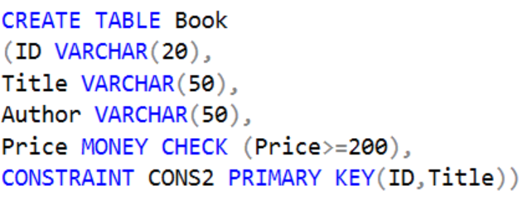
5. Primary Key(cont…)
Composite Primary Key Constraint Example :

Slide 13

5. Primary Key(cont…)
After the table is created
EX:
Alter Table table_name
Add Primary key (column_name1, column_name2,.. )

Slide 14
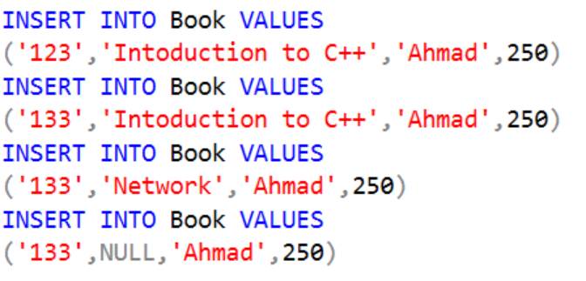
5. Primary Key(cont…)
In composite primary key, we can repeat data or put null in
one of the columns

Slide 15
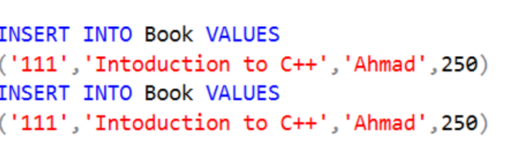
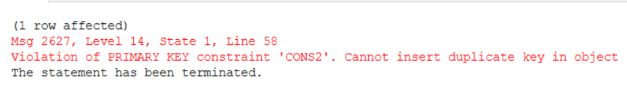
5. Primary Key(cont…)
But if we repeat data or put null in both if them an error will appear

Slide 16


5. Primary Key(cont…)
But if we repeat data or put null in both if them an error will appear

Slide 17
Constraints
Constraints
NOT NULL
CHECK
DEFAULT
PRIMARY KEY
FOREIGN KEY
UNIQUE

Slide 18
6. Foreign Key
The FOREIGN KEY, or referential integrity constraint, designates a column or combination of columns as a foreign key and establishes a relationship between a primary key or a unique key in the same table or a different table.
A FOREIGN KEY in one table points to(References to) a PRIMARY KEY in another table.
Let's illustrate the foreign key with an example, Look at the following two tables:

Slide 19
6. Foreign Key(Cont…)
Sections :
Data type of PRIMARY KEY and FOREIGN
KEY must be same.
SectionName | SectionNum
Programming | 1
Network | 2
Primary
Key
Foreign
Key
Employees :
SectionNum | EmpName | EmpNum
1 | Ahmad | 1
2 | Omar | 2
2 | Khaled | 3
1 | Sami | 4

Slide 20
6. Foreign Key(Cont…)
You Can add Foreign Key Constraint:
1. when a table is created:
Table level | Column level
CREATE TABLE table_name ( column_name Datatype ,…., CONSTRAINT Constraint_Name FOREIGN KEY column_name REFERENCES table_name_of_primary_key (column_name) ) | CREATE TABLE table_name ( column_name Datatype FOREIGN KEY REFERENCES table_name_of_primary_key (column_name) , …, )

Slide 21
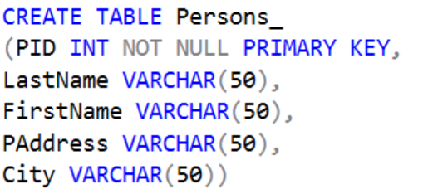
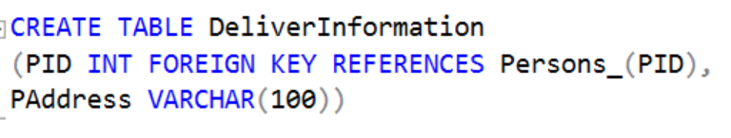
6. Foreign Key(Cont…)
Ex of Column level:

Slide 22
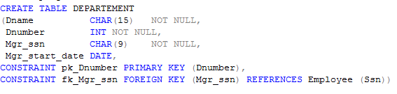
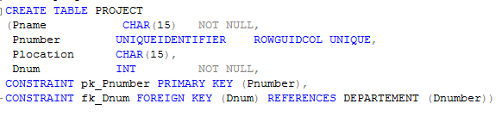
6. Foreign Key(Cont…)
Ex of Table level:

Slide 23
6. Foreign Key(cont…)
After the table is created
Alter Table table_name
Add Foreign key coulmn_name REFERENCES table_name_of_primary_key (column_name)

Slide 24
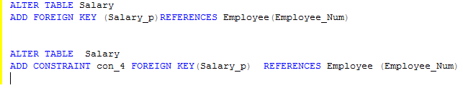
6. Foreign Key(cont…)
After the table is created
EX:
Naming a constraint

Slide 25
:Primary Key& Foreign Keyشروط وفكرة وجود
Foreign Key | Primary Key
1. أساس وجوده هو ربط الجداول ببعضها. وكأنه أخذ نسخة من PK ونضعها في جدول اخر وذلك لربط هذا الجدول(الذي يحتوي على FK ) بالجدول الذي يحتوي على PK | 1. هو مفتاح أساسي بمعرفته أستطيع ربط الجداول ببعضها. لكل جدول يوجد به PK واحد أو قد لا يوجد به، فأما اذا وجد أكثر من عامود يمكن اختياره PK نختار أحد هذه الأعمدة PK وبقية الأعمدة المميزة تُعين unique EX: PK(ID) PK(ID, Name)
2. شروطFK : يسمح بتكرار القيم. يسمح بوجود NULL قيم FK لابد تكون من ضمن قيم PK واذا وُجدت قيمة في FK غير موجودة في PK يعتبر هذا فيه تعدي على Referential Constraints | 2. شروطPK : لا يسمح بتكرار القيم. لا يسمح بوجود NULL
3- FK يمكن ان يكون باسم مختلف عن PK لكن لا بد أن تكون Data Type لكل منFK&PK هي نفسها.
4- لكل جدول قد يوجد فيه FK واحد او أكثر و يمكن وجود جدول بدون FK | 4- الجدول الواحد ممكن يكون له PKواحد فقط أو لا يوجد له PK وأهمية PK تكمن في ربط الجداول لأنه اذا لم يوجد في الجدول PK لا أستطيع ربط الجداول ببعض.

Slide 26
Basic Retrieval Queries in SQL: SELECT

Slide 27
SQL statement
3. Data Query Language(DQL) | SELECT

Slide 28
Difference Between Query and Transaction:
Query | Transaction
Case some data to be retrieved | Cause read and write of data
Query is DQL | A transaction consists of a collection of DML statements Such as: INSERT UPDATE DELETE

Slide 29
SELECT
One basic statement for retrieving information from a database.
Select command Retrieves certain records from one or more tables.
We can use SELECT with lots of clauses , Today we gonna study three cases that use with select command:
1. SQL WHERE clause
SELECT column1, column2, …. FROM table_name
SELECT column1, column2, …. FROM table_name WHERE [condition]

Slide 30
SQL WHERE clause
Equal | =
(Not Equal) | <>
(Greater than) | >
(Greater or Equal) | >=
(Less than) | <
(Less or Equal) | <=

Slide 31
SELECT(cont…)
EX:
Query : Retrieve the birth date and address of the employee (s)whose name is ‘John B. Smith’.
AddresFs | Bdate | Lname | Minit | Fname
731Fondern, Houston , TX | 1965-01-09 | Smith | B | John
789 Fondern, Houston, TY | 1989-01-09 | Marry | DD | John
SELECT Bdate, AddresFs
FROM EMPLOYEE
WHERE Fname='John' AND Minit='B' AND Lname='Smith';

Slide 32
SELECT(cont…)
2. To retrieve all the attribute values of the selected tuples (all the fields available in the table), we do not have to list the attribute names explicitly in SQL:
EX1: Query: retrieves all the attribute values of any EMPLOYEE who works in DEPARTMENT number 5
SELECT * FROM table_name
select * from employee where Dno=5

Slide 33

SELECT(cont…)
EX2 Query:
retrieves all the attributes of an EMPLOYEE and the attributes of the DEPARTMENT in which he or she works for every employee of the ‘Research’ department
select * from employee, DEPARTEMENT
where Dname='Research' AND Dno=Dnumber

Slide 34
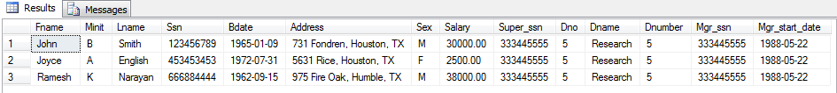
SELECT(cont…)
Contents of EMPLOYEE Table
Contents of DEPARTMENT

Slide 35
SELECT(cont…)
2. SQL ORDER BY clause:
The SQL ORDER BY clause is used to sort the data in ascending or descending order.
SELECT columns FROM table_name ORDER BY column1 ASC | DESC

Slide 36
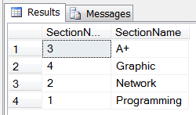
SELECT(cont…)
This shows the records according to the order of Section name

Slide 37
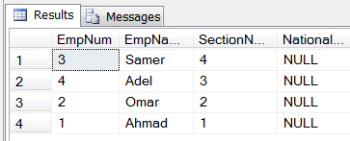
SELECT(cont…)
EX2: Select all records from Employees table using Descending order on SectionNum.

Slide 38
SELECT columns from more than table
If Tables haven't a relationship:
To retrieve records , you have to specify and put descriptions as you can by using more than one conditions.
Look to the following example:
CREATE DATABASE lab_4
CREATE TABLE Book(B_id VARCHAR(10), Title VARCHAR(40))
CREATE TABLE Author ( A_id VARCHAR(10), name VARCHAR(10))
INSERT INTO Book VALUES ('1234','CS' )
INSERT INTO Book VALUES ('1235','IS' )
INSERT INTO Book VALUES ('1236','BS' )
Insert into author values ('1112','Ahamad' )
INSERT INTO Author VALUES ('1113','Khaled' )
INSERT INTO Author VALUES ('1114','Mohammed' )

Slide 39
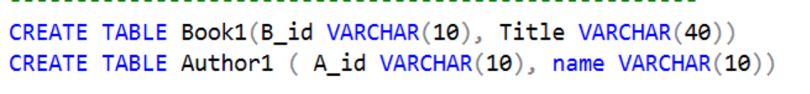
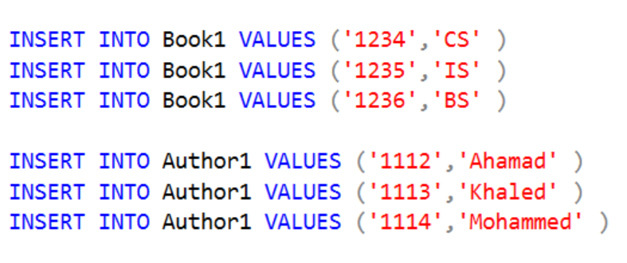
SELECT columns from more than table

Slide 40


SELECT columns from more than table
If Tables haven't a relationship :
Look to these different queries that try to retrieve records:
This query ends up with wrong data(logic error) , output must be one record, ‘Ahmad’ is one person in Author table.
Because it used more than one tables
and there is no relation between them
and the strong reason is: there is only one condition descries this query.
so, No enough descriptions are entered.

Slide 41
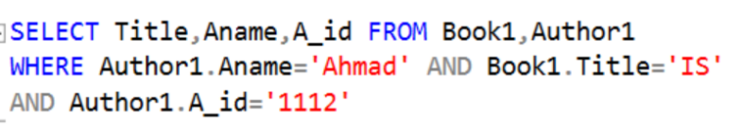
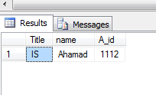
SELECT columns from more than table
If Tables haven't a relationship :
Look to these different queries that try to retrieve records:
Because of there are more conditions describe the record, this query ends up with correct data.

Slide 42
SELECT columns from more than table
For tables that haven’t relationship ,there is no other method.
So, the solution is:
you have to specify and put descriptions as you can by using more than one conditions.
But this solution is useless because you need to specify the descriptions for all the columns that you want.
For tables that have relationship ,To solve this issue , you have to use Join query which is:
SQL joins are used to query data from two or more tables, based on a relationship between certain columns in these tables. Lab8 insallah

Slide 43

Exercise
Create a data base (company_lab4)
Create two tables in the database:
3.Retrieve all the attribute values from each table.
4.Select all records from Employee table using ascending order on Salary.
5.Retrieve employee_no and Salary where their employee name is 'Ahmad‘.
Employee
employee_no | e_name | Salary | phone
1456 | Ahmad | 4000 | 0555558888
1457 | Khaled | 4500 | 0555553333
1458 | Ahmad | 3000 | 0555554444
1459 | Mohamed | 6000 | 0555555777
department
d_no | d_name | manager_no
1 | CS | 1457
2 | IS | 1459
Note: employee_no and d_no primary key

